Slide 1
Importance of Marketing Scope of Marketing Core Marketing Concepts
MG1002 MARKETING MANAGEMENT
PART - I:
Understanding Marketing Management
CHAPTER 1
Instructor: Dr. Syed Shujaat Ali Shah peershujaat92@lhr.nu.edu.pk

Slide 2
Welcome to the world of MARKETING

Slide 3
Importance of Marketing WHY IT IS REQUIRED?
Financial success ⬄ Marketing Ability
Making the right decision - Simple?
Skillful marketing: A never-ending pursuit…

Slide 4
Scope of Marketing DEFINITIONS
“Marketing is an organizational function and a set of processes for creating, communicating, and delivering value to customers and for managing customer relationships in ways that benefit the organization and its stakeholders”
American Marketing Association (AMA)
Marketing is the activity, set of institutions, and processes for creating, communicating, delivering, and exchanging offerings that have value for customers, partners, and society at large.

Slide 5

Scope of Marketing DEFINITIONS
“Marketing management is the art and science of choosing target markets and getting, keeping, and growing customers through creating, delivering, and communicating superior customer value” C- Creating
C- Communicating
D- Delivering
V- Something of Value
T- to the TARGET market
P- in a PROFITABLE manner
Philip Kotler
“Marketing is a societal process by which individuals and groups obtain what they need and want through creating, offering, and freely exchanging products and services of value with others”
Societal definition of marketing

Slide 6
Scope of Marketing DEFINITIONS
A simple yet comprehensive definition:
Marketing is…..
Meeting Needs Profitably

Slide 7
Scope of Marketing WHAT CAN BE MARKETED?
Can you market?
Ideas
People
Information
Experiences
How?
What else?
REF: BOOK FOR COMPLETE DISCUSSION

Slide 8
Scope of Marketing WHO MARKETS?
Marketer, someone who seeks a Response from another party, called Prospect
Response can be … ?
Marketers are responsible for Demand Management
REF: BOOK FOR COMPLETE DISCUSSION

Slide 9
Scope of Marketing Marketing Management
Combination of marketing and Management
Management Functions
Planning
Organizing
Leading/Directing
Controlling
Choosing the Right Target Market
Grooming the Right Target Market
Delivering Superior Value to the Target Market

Slide 10
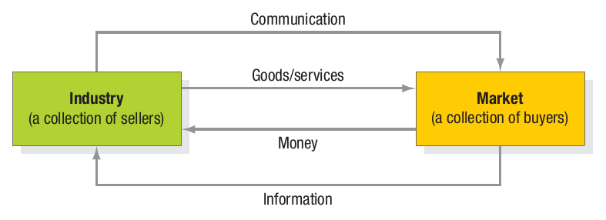
Scope of Marketing WHO MARKETS?
Markets, collection of buyers and sellers who transact over a particular product or product class

Slide 11
Core Marketing Concepts
Needs
Basic Human Requirements
Wants
Needs which are directed to a specific object
Demands
Wants for specific products backed by ability to pay (acquire)

Slide 12
Core Marketing Concepts
Satisfying everyone……Yes/No? How? Why?
Target Markets & Segmentation
Different segments based on several factors
Segments presenting greatest opportunity
Positioning
Positioned carefully as delivering certain benefits

Slide 13
Core Marketing Concepts
Value is ‘perceived’ tangible and intangible benefits and costs to customers
Satisfaction is fulfillment of a need
*WRONG*
Satisfaction is Person’s comparative judgments resulting from a product’s perceived performance
If performance < expectations: dissatisfied/disappointed
If performance>=expectations: satisfied/delighted

Slide 14
Core Marketing Concepts
Marketing Channels
Communication channels
Interacting with target buyers with the message
Distribution channels
Display, sell or deliver the product or service
Service channels
Facilitating transactions with buyers

Slide 15
Core Marketing Concepts
Supply Chain (vs. Marketing Channel)
Marketing Channel: Marketer to target buyer
While
Supply Chain: A complete value delivery system
From Raw materials to components to final buyers
Raw materials
Manufacturer
[End] Consumer

Slide 16
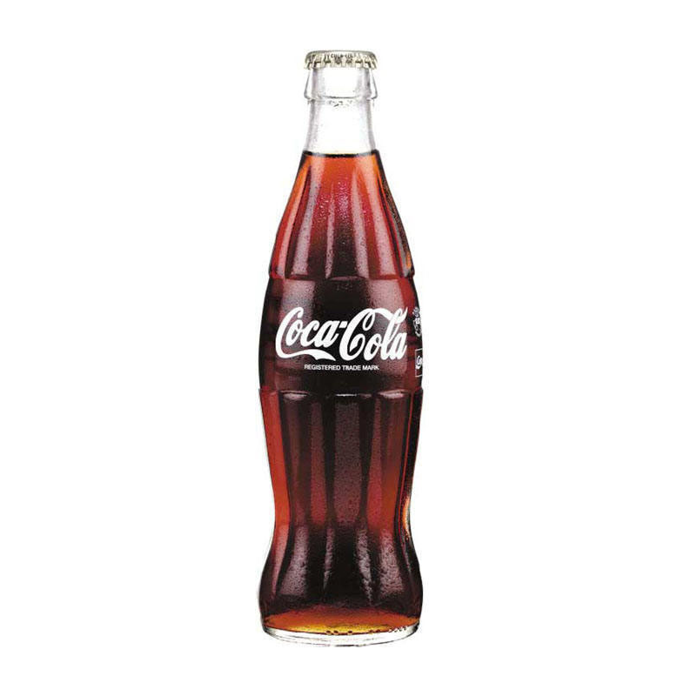


Core Marketing Concepts
Competition
All the actual and potential rival offerings and substitutes that a buyer might consider
Think about major competitor(s) – brands OR products – for:

Slide 17
Core Marketing Concepts
Marketing Environment
Broad Environment
Demographic Environment
Economic Environment
Physical Environment
Technological Environment
Political-legal Environment
Social-cultural Environment
Task Environment

Slide 18
Company Orientations toward the marketplace
What are ‘orientations’ (or concepts) toward the marketplace?
Company Orientations …
Selling
Product
Marketing
Production
Holistic Marketing

Slide 19
Company Orientations toward the marketplace
The Production Concept
Consumers will favor products that are “widely available” & “inexpensive”
Focus on “Production”
Examples?

Slide 20
Company Orientations toward the marketplace
The Product Concept
Consumer will favor those products that offer the most quality, performance or innovation
Focus entirely on “Product development”
What if: not priced, distributed, advertised and sold properly?
Examples?

Slide 21
Company Orientations toward the marketplace
The Selling Concept
Customers (consumers & businesses), if not engaged, will not buy enough
Aggressive selling & promotion is required
Practiced with unsought goods
Examples?

Slide 22
Company Orientations toward the marketplace
The Marketing Concept
Replace product-centered “make-and-sell” with “sense-and-respond”
Reactive market orientation
Proactive market orientation
Examples?

Slide 23
Company Orientations toward the marketplace
The Holistic Marketing Concept
“Everything matters”
Based on the development, design and implementation of marketing programs, processes, and activities that recognizes their importance and interdependencies
4 Components: Relationship marketing | Integrated marketing Internal marketing | Social responsibility marketing / Performance Marketing

Slide 24
Company Orientations toward the marketplace
The Holistic Marketing Concept
Marketing Department
Integrated Marketing
Relationship Marketing
Customers
Channel
Partners
Socially Responsible Marketing
Ethics
4P’s Product Price Place Promotion
Senior Management
Other departments
Environment
Legal
Community
Internal Marketing

Slide 25
Marketing Management Tasks
Developing Marketing Strategies & plans
Capturing market insights
Connecting with customers
Building Strong brands
Shaping the Market Offerings
Delivering Value
Communicating Value
Creating successful long-term growth

